Slide 1
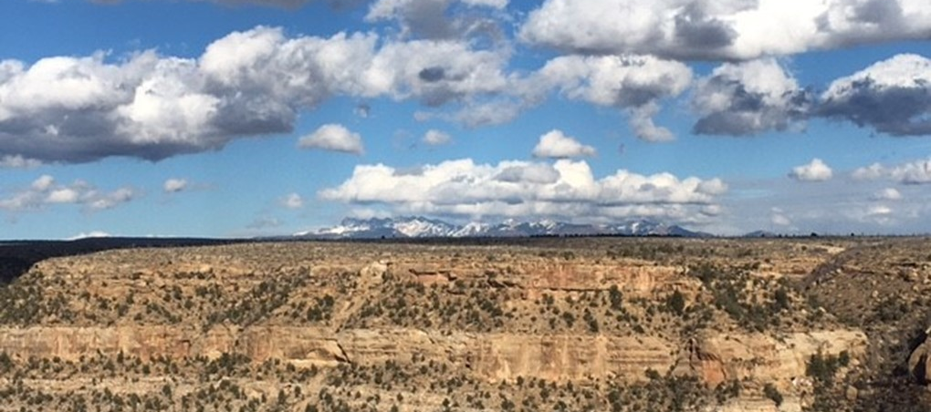
Climate Literacy in Natural Resources
NRES 208 || 3 credit hours
Explore how climate shapes the world
and its natural resources
Required for
Environmental Science major & Applied Climate Science minor
No Prerequisites
Understand
  Earth’s climate system
  Earth’s six interconnected spheres
  Challenges of climate change
Fall 2025
MWF 9-9:50
163 Hardin Hall
Questions?
Michael Hayes mhayes2@unl.edu

